Slide 1
PI-RADS Assessment (v2.1)
Jelle Barentsz, Patrik Zamecnik, Maarten de Rooij
Radboudumc, Andros Clinics, The Netherlands

Slide 2
No Conflicts of Interest
Jelle Barentsz@JelleBarentsz
jelle.barentsz@radboudumc.nl
www.mri-prostate-barentsz.nl

Slide 3
PI-RADS v2.1: Assessment Categories
Each lesion is assigned a PI-RADS Assessment Category using a 5-point Likert-scale based on the likelihood (probability) that findings on:
T2W (anatomy), DWI (cell-density), and DCE (vascularity) correlate with the presence of a clinically significant cancer at a particular location
1 very low clinically significant cancer highly unlikely
2 low clinically significant cancer unlikely
3 intermediate clinically significant cancer equivocal
4 high clinically significant cancer likely
5 very high clinically significant cancer highly likely

Slide 4
PI-RADS v2.1
Different weighting for PZ and TZ

Slide 5
PI-RADS v2.1
Different weighting for PZ and TZ
- PZ → DWI (cell-density)

Slide 6
PI-RADS v2.1
Different weighting for PZ and TZ
- PZ → DWI (cell-density)
- TZ → T2W (anatomy)

Slide 7
PI-RADS v2.1
Different weighting for PZ and TZ
- PZ → DWI (cell-density)
- TZ → T2W (anatomy)
- DCE (vascularity) minor role

Slide 8
PI-RADS v2.1
Simple algorithms and tables
to determine overall score
(Assessment Category)

Slide 10
Uniformly hyperintense signal intensity (normal)
Linear, wedge-shaped, or diffuse mild hypointensity, usually indistinct margin
PIRADS v2.1: T2W: PZ
Uniformly hyperintense signal intensity (normal)
Linear, wedge-shaped, or diffuse mild hypointensity, usually indistinct margin
3 Heterogeneous signal intensity or non-circumscribed, rounded, moderate hypointensity
4 Circumscribed, homogenous moderate hypointense focus/mass confined to prostate and <1.5 cm in greatest dimension
5 Same as 4 but ≥1.5cm in greatest dimension or definite extraprostatic extension/invasive behavior

Slide 11
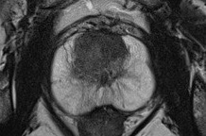
Uniformly hyperintense signal intensity (normal)
Linear, wedge-shaped, or diffuse mild hypointensity, usually indistinct margin
PIRADS v2.1: T2W: PZ
Uniformly hyperintense signal intensity (normal)

Slide 12
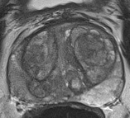
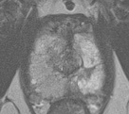
Uniformly hyperintense signal intensity (normal)
Linear, wedge-shaped, or diffuse mild hypointensity, usually indistinct margin
PIRADS v2.1: T2W: PZ
Diffuse mild hypo-intensity (usually indistinct margin), or wedge-shaped

Slide 13
Uniformly hyperintense signal intensity (normal)
Linear, wedge-shaped, or diffuse mild hypointensity, usually indistinct margin
PIRADS v2.1: T2W: PZ
Diffuse mild hypo-intensity (usually indistinct margin)

Slide 14
Uniformly hyperintense signal intensity (normal)
Linear, wedge-shaped, or diffuse mild hypointensity, usually indistinct margin
PIRADS v2.1: T2W: PZ
Diffuse mild hypo-intensity (usually indistinct margin), or wedge-shaped

Slide 15
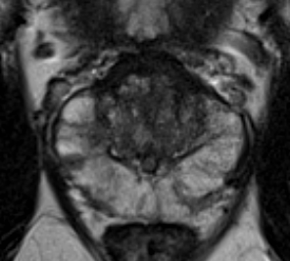
Uniformly hyperintense signal intensity (normal)
Linear, wedge-shaped, or diffuse mild hypointensity, usually indistinct margin
PIRADS v2.1: T2W: PZ
Circumscribed, homogenous moderate hypointense focus/mass confined to prostate and <1.5 cm in greatest dimension

Slide 16
Uniformly hyperintense signal intensity (normal)
Linear, wedge-shaped, or diffuse mild hypointensity, usually indistinct margin
PIRADS v2.1: T2W: PZ
Circumscribed, homogenous moderate hypointense focus/mass confined to prostate and <1.5 cm in greatest dimension

Slide 17
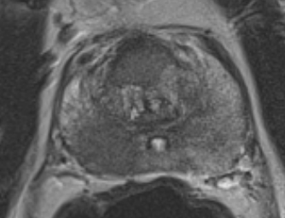
Uniformly hyperintense signal intensity (normal)
Linear, wedge-shaped, or diffuse mild hypointensity, usually indistinct margin
PIRADS v2.1: T2W: PZ
5 Same as 4 but ≥1.5cm in greatest dimension or definite extraprostatic extension/invasive behavior

Slide 18
Uniformly hyperintense signal intensity (normal)
Linear, wedge-shaped, or diffuse mild hypointensity, usually indistinct margin
PIRADS v2.1: T2W: PZ
5 Same as 4 but ≥1.5cm in greatest dimension or definite extraprostatic extension/invasive behavior
>1.5 cm

Slide 19
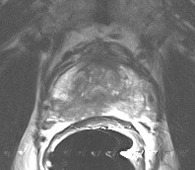
Uniformly hyperintense signal intensity (normal)
Linear, wedge-shaped, or diffuse mild hypointensity, usually indistinct margin
PIRADS v2.1: T2W: PZ
5 Same as 4 but ≥1.5cm in greatest dimension or definite extraprostatic extension/invasive behavior
>1.5 cm

Slide 20
Uniformly hyperintense signal intensity (normal)
Linear, wedge-shaped, or diffuse mild hypointensity, usually indistinct margin
PIRADS v2.1: T2W: PZ
5 Same as 4 but ≥1.5cm in greatest dimension or definite extraprostatic extension/invasive behavior

Slide 21
Uniformly hyperintense signal intensity (normal)
Linear, wedge-shaped, or diffuse mild hypointensity, usually indistinct margin
PIRADS v2.1: T2W: PZ
5 Same as 4 but ≥1.5cm in greatest dimension or definite extraprostatic extension/invasive behavior
Obliteration of RP angle

Slide 22
Uniformly hyperintense signal intensity (normal)
Linear, wedge-shaped, or diffuse mild hypointensity, usually indistinct margin
PIRADS v2: T2W: TZ
Homogeneous intermediate signal intensity or containing
fully encapsulated heterogenous BPH-nodules
Circumscribed hypo-intense nodules or partially
encapsulated heterogenous BPH nodules
Non-circumscribed non-encapsulated hypo-intense or
heterogeneous nodules, or others than 1, 2, 4 or 5
4 Non-circumscribed, homogenous moderate hypointense, and <1.5 cm in greatest dimension
5 Same as 4 but ≥1.5cm in greatest dimension or definite extraprostatic extension/invasive behavior

Slide 23
Uniformly hyperintense signal intensity (normal)
Linear, wedge-shaped, or diffuse mild hypointensity, usually indistinct margin
PIRADS v2: T2W: TZ
Homogeneous intermediate signal intensity or containing
fully encapsulated heterogenous BPH-nodules
Circumscribed hypo-intense nodules or partially
encapsulated heterogenous BPH nodules
Non-circumscribed non-encapsulated hypo-intense or
heterogeneous nodules, or others than 1, 2, 4 or 5
4 Non-circumscribed, homogenous moderate hypointense, and <1.5 cm in greatest dimension
5 Same as 4 but ≥1.5cm in greatest dimension or definite extraprostatic extension/invasive behavior
“New”

Slide 24
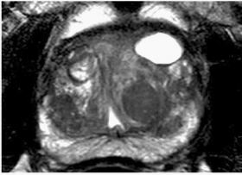
Uniformly hyperintense signal intensity (normal)
Linear, wedge-shaped, or diffuse mild hypointensity, usually indistinct margin
PIRADS v2.1: T2W: TZ
Homogeneous intermediate signal intensity or containing
fully encapsulated heterogenous BPH-nodules
“New”
T2W

Slide 25
Uniformly hyperintense signal intensity (normal)
Linear, wedge-shaped, or diffuse mild hypointensity, usually indistinct margin
PIRADS v2.1: T2W: TZ
Circumscribed hypo-intense nodules or partially
encapsulated heterogenous BPH nodules
“New”
T2W

Slide 26
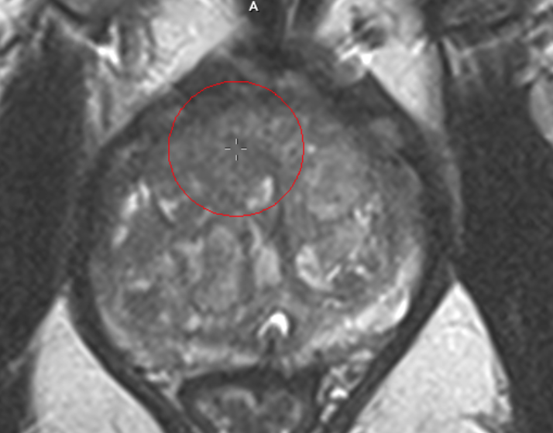
Uniformly hyperintense signal intensity (normal)
Linear, wedge-shaped, or diffuse mild hypointensity, usually indistinct margin
PIRADS v2.1: T2W: TZ
Non-circumscribed non-encapsulated hypo-intense or
heterogeneous nodules, or others than 1, 2, 4 or 5

Slide 27
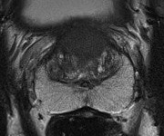
Uniformly hyperintense signal intensity (normal)
Linear, wedge-shaped, or diffuse mild hypointensity, usually indistinct margin
PIRADS v2.1: T2W: TZ
4 Non-circumscribed, homogenous moderate hypointense lesions

Slide 28
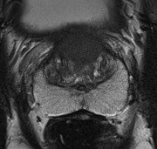
PIRADS v2.1: T2W: TZ
4 Non-circumscribed, homogenous moderate hypointense lesions
Organised Chaos

Slide 29
PIRADS v2.1: T2W: TZ
4 Non-circumscribed, homogenous moderate hypointense lesions
Organised Chaos

Slide 30
Uniformly hyperintense signal intensity (normal)
Linear, wedge-shaped, or diffuse mild hypointensity, usually indistinct margin
PIRADS v2.1: T2W: TZ
4 Non-circumscribed, homogenous moderate hypointense lesions
Erased Charcoal

Slide 31
Uniformly hyperintense signal intensity (normal)
Linear, wedge-shaped, or diffuse mild hypointensity, usually indistinct margin
PIRADS v2.1: T2W: TZ
4 Non-circumscribed, homogenous moderate hypointense lesions
Erased Charcoal

Slide 32
Uniformly hyperintense signal intensity (normal)
Linear, wedge-shaped, or diffuse mild hypointensity, usually indistinct margin
Disruption of Organised Chaos
Disruption

Slide 33
Uniformly hyperintense signal intensity (normal)
Linear, wedge-shaped, or diffuse mild hypointensity, usually indistinct margin
PIRADS v2.1: T2W: TZ
5 Non-circumscribed, homogenous moderate hypo-intense, and
>1.5 cm in greatest dimension
16 mm

Slide 34
Uniformly hyperintense signal intensity (normal)
PIRADS v2.1: DWI (both TZ & PZ)
No abnormality (i.e. normal) on ADC and high b-value DWI
2 Non-focal hypo-intense on ADC and/or non-focal
hyper-intense on high b-value DWI
Focal mildly/moderately hypo-intense on ADC and iso-intense/mildly hyper-intense on high b-value DWI
Focal markedly hypo-intense on ADC and markedly hyper-intense on high b-value DWI; <1.5cm on axial
Same as 4 but ≥1.5cm in greatest dimension or definite extra-prostatic extension/invasive behavior

Slide 35
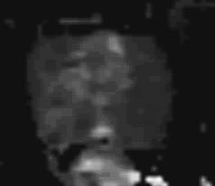
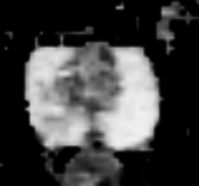
Uniformly hyperintense signal intensity (normal)
PIRADS v2.1: DWI
No abnormality (i.e. normal) on ADC and high b-value DWI
b1400
ADC

Slide 36
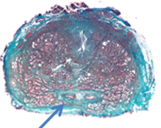
Uniformly hyperintense signal intensity (normal)
Pitfall: muscular sleeve of ejaculatory ducts
b1400
ADC map - axial

Slide 37
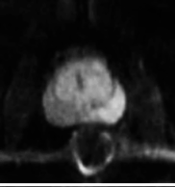
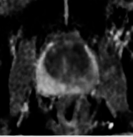
Uniformly hyperintense signal intensity (normal)
PIRADS v2.1: DWI
Non-focal hypo-intense on ADC and/or non-focal
hyper-intense on high b-value DWI
2
b1400
ADC map

Slide 38
Uniformly hyperintense signal intensity (normal)
PIRADS v2.1: DWI
Focal hyper-intense on high b-value DWI or focal hypo-intense ADC, but not both
3
b1400
ADC map
b1400

Slide 39
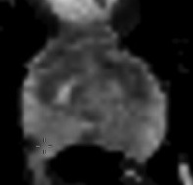
Uniformly hyperintense signal intensity (normal)
PIRADS v2.1: DWI
Focal markedly hypo-intense on ADC
ADC

Slide 40
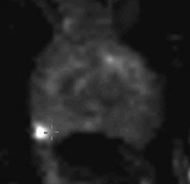
Uniformly hyperintense signal intensity (normal)
PIRADS v2.1: DWI
Focal markedly hypo-intense on ADC AND markedly
hyper-intense on high b-value DWI; <1.5cm on axial
b1400
ADC

Slide 41
Uniformly hyperintense signal intensity (normal)
PIRADS v2.1: DWI
Focal markedly hypo-intense on ADC AND markedly
hyper-intense on high b-value DWI; <1.5cm on axial
b1400
ADC

Slide 42
PI-RADS v2.1
DCE-MRI also morphologic descriptors
no early or contemporaneous enhancement, or diffuse/widespread enhancement
not corresponding to a focal finding
on T2-WI and/or DWI
-

Slide 43
PI-RADS v2.1
DCE-MRI also morphologic descriptors
Focal and earlier than or contemporaneously with enhancement of adjacent normal prostatic tissues, AND;
corresponds to suspicious finding on T2-WI and/or DWI
+

Slide 44
PI-RADS v2.1
DCE-MRI also morphologic descriptors
no early or contemporaneous enhancement, or diffuse/widespread enhancement
not corresponding to a focal finding
on T2-WI and/or DWI
focal enhancement corresponding to a lesion demonstrating features of BPH on T2-WI
-
“New”

Slide 45
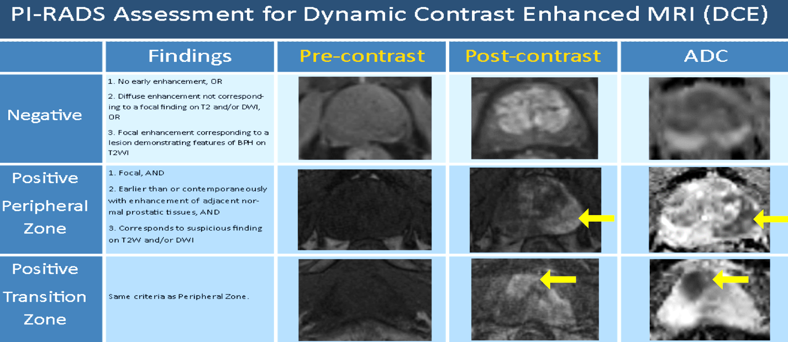

Slide 47
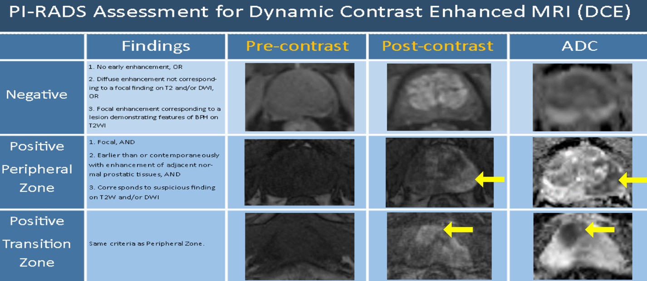

Slide 51
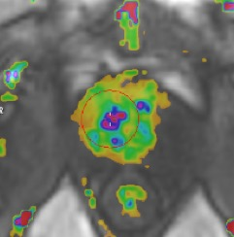
PI-RADS v2.1: DCE-MRI uses also morphologic
enhancement descriptors
“New”
Pop-corn -> BPH

Slide 52
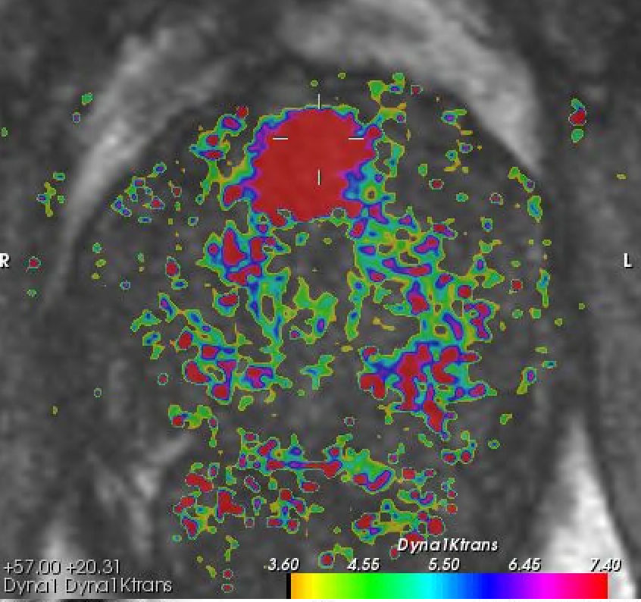
PI-RADS v2.1: DCE-MRI uses also morphologic
enhancement descriptors
“New”
Confluent -> GS 5+4

Slide 53
Peripheral Zone
PI-RADS
Assessment Category
Transition Zone
PI-RADS 1
PI-RADS 2
PI-RADS 3
PI-RADS 4
PI-RADS 5

Slide 54
Peripheral Zone
PI-RADS
Assessment Category
DWI/ADC
Score 1
PI-RADS 1
Score 2
PI-RADS 2
Score 3
PI-RADS 3
Score 4
PI-RADS 4
Score 5
PI-RADS 5

Slide 55
Peripheral Zone
PI-RADS
Assessment Category
DWI/ADC
Score 1
PI-RADS 1
Score 2
PI-RADS 2
Score 3
PI-RADS 3
DCE +
Score 4
PI-RADS 4
Score 5
PI-RADS 5

Slide 56
PI-RADS
Assessment Category
Transition Zone
T2-WI
PI-RADS 1
Score 1
PI-RADS 2
Score 2
PI-RADS 3
Score 3
PI-RADS 4
Score 4
PI-RADS 5
Score 5

Slide 57
PI-RADS
Assessment Category
Transition Zone
T2-WI
PI-RADS 1
Score 1
“New”
PI-RADS 2
Score 2
DWI >4
PI-RADS 3
Score 3
PI-RADS 4
Score 4
PI-RADS 5
Score 5

Slide 58
PI-RADS
Assessment Category
Transition Zone
T2-WI
PI-RADS 1
Score 1
PI-RADS 2
Score 2
DWI >4
PI-RADS 3
Score 3
DWI 5
PI-RADS 4
Score 4
PI-RADS 5
Score 5

Slide 59
Peripheral Zone
PI-RADS
Assessment Category
Transition Zone
DWI/ADC
T2-WI
Score 1
PI-RADS 1
Score 1
Score 2
PI-RADS 2
Score 2
DWI >4
Score 3
PI-RADS 3
Score 3
DCE +
DWI 5
Score 4
PI-RADS 4
Score 4
Score 5
PI-RADS 5
Score 5

Slide 60
Thank you
For Your Attention
Jelle Barentsz@JelleBarentsz
jelle.barentsz@radboudumc.nl
www.mri-prostate-barentsz.nl

